Slide 1

Inheritance, Interfaces, and Abstract classes

Slide 2
Topics
Inheritance Concepts
Inheritance Design
Inherited Members of a Class
Subclass Constructors
Adding Specialization to the Subclass
Overriding Inherited Methods
The protected Access Modifier
Interfaces

Slide 3
Inheritance Concepts
A common form of reuse of classes is inheritance.
We can organize classes into hierarchies of functionality.
The class at the top of the hierarchy (superclass) defines instance variables and methods common to all classes in the hierarchy.
We derive a subclass, which inherits behavior and fields from the superclass.

Slide 4
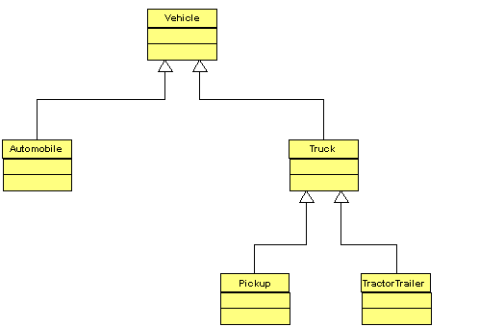
A Sample Vehicle Hierarchy
This hierarchy is depicted using a Unified Modeling Language (UML) diagram.
In UML diagrams, arrows point from the subclass to the superclass.

Slide 5
Superclasses and Subclasses
A superclass can have multiple subclasses.
Subclasses can be superclasses of other subclasses.
A subclass can inherit directly from only one superclass.
All classes inherit from the Object class.

Slide 6
Specifying Inheritance
The syntax for defining a subclass is to use the extends keyword in the class header, as in
accessModifier class SubclassName extends SuperclassName
{
// class definition
}
The superclass name specified after the extends keyword is called the direct superclass.
As mentioned, a subclass can have many superclasses, but only one direct superclass.

Slide 7
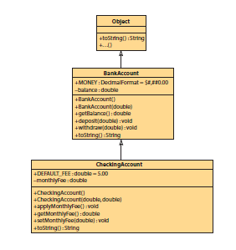
The BankAccount Hierarchy

Slide 8
The toString Method
Returns a String representing the data of an object
Clients can call toString explicitly by coding the method call.
Clients can call toString implicitly by using an object reference where a String is expected.
Example client code:
Auto compact = new Auto( ); // instantiate
// an object
// explicit toString call
System.out.println( compact.toString( ) );
// implicit toString call
System.out.println( compact );

Slide 9
The toString API
Return value | Method name and argument list
String | toString( ) returns a String representing the data of an object

Slide 10
Inheritance Rules
Superclass Members | Inherited by subclass? | Directly Accessible by Subclass? | Directly Accessible by Client of Subclass?
public fields | yes | yes, by using field name | yes
public methods | yes | yes, by calling method from subclass methods | yes
protected fields | yes | yes, by using field name | no, must call accessors and mutators
protected methods | yes | yes, by calling method from subclass methods | no
private fields | no | no, must call accessors and mutators | no, must call accessors and mutators
private methods | no | no | no

Slide 11
Subclass Constructors
Constructors are not inherited.
However, the subclass can and should call the constructors of the superclass to initialize inherited fields.
Implicit invocation
The default constructor of the subclass automatically calls the default constructor of the superclass
For explicit invocation, use this syntax:
super( argument list );
If used, this statement must be the first statement in the subclass constructor

Slide 12
Inheritance Rules for Constructors
Superclass Members | Inherited by subclass? | Directly Accessible by Subclass? | Directly Accessible by Client of Subclass Using a Subclass Reference?
constructors | no | yes, using super( arg list ) in a subclass constructor | no

Slide 13
Overriding Inherited Methods
A subclass can override (or replace) an inherited method by providing a new version of the method.
The API of the new version must match the inherited method.
When the client calls the method, it will call the subclass version.
Overridden superclass methods are invisible to the client of the subclass, but the subclass methods can still call a superclass method using this syntax:
super.methodName( argument list )

Slide 14
Inheritance Rules for Overridden Methods
Superclass Members | Inherited by Subclass? | Directly Accessible by Subclass? | Directly Accessible by Client of Subclass Using a Subclass Reference?
public or protected inherited methods that have been overridden in the subclass | no | yes, using super.methodName( arg list ) | no

Slide 15
The protected Access Modifier
Declaring fields as private preserves encapsulation.
Subclass methods call superclass methods to set the values of the fields, and the superclass methods enforce the validation rules for the data.
But calling methods incurs processing overhead.
Declaring fields as protected allows them to be accessed directly by subclass methods.
Classes outside the hierarchy and package must use accessors and mutators for protected fields.
Notes:
Processing Overhead: Whenever a method is called, the JVM saves the return address and makes copy of the arguments. Then when the methods completes, the JVM makes a copy of the return value to the caller.

Slide 16
Interfaces
Interfaces are syntactically similar to classes, but they lack instance variables, and their methods are declared without any body.
Once it is defined, any number of classes can implement an interface. Also, one class can implement any number of interfaces.
Interfaces are designed to support dynamic method resolution at run time.

Slide 17
Interfaces Syntax
access interface-name{
return-type method-name1(argument list);
return-type method-name2(argument list);
……………………..
……………………..
return-type method-nameN(argument list);
}
The java compiler adds public and abstract keywords before the interface method and public static and final keywords before data members.

Slide 18
How Interfaces differ from Classes
An interface cannot be instantiated.
An interface does not contain any constructors.
All of the methods in an interface are abstract.
An interface cannot contain instance fields. The only field that can appear in an interface must be declared both static and final.
An interface is not extended by a class; it is implemented by a class.
An interface can extend multiple interfaces.

Slide 19
Abstract Classes
A class which contains the abstract keyword in its declaration is known as abstract class.
Abstract classes may or may not contain abstract methods.
But, if a class has at least one abstract method, then the class must be declared abstract.
If a class is declared abstract, it cannot be instantiated.
To use an abstract class, you have to inherit it from another class, provide implementations to the abstract methods in it.

Slide 20
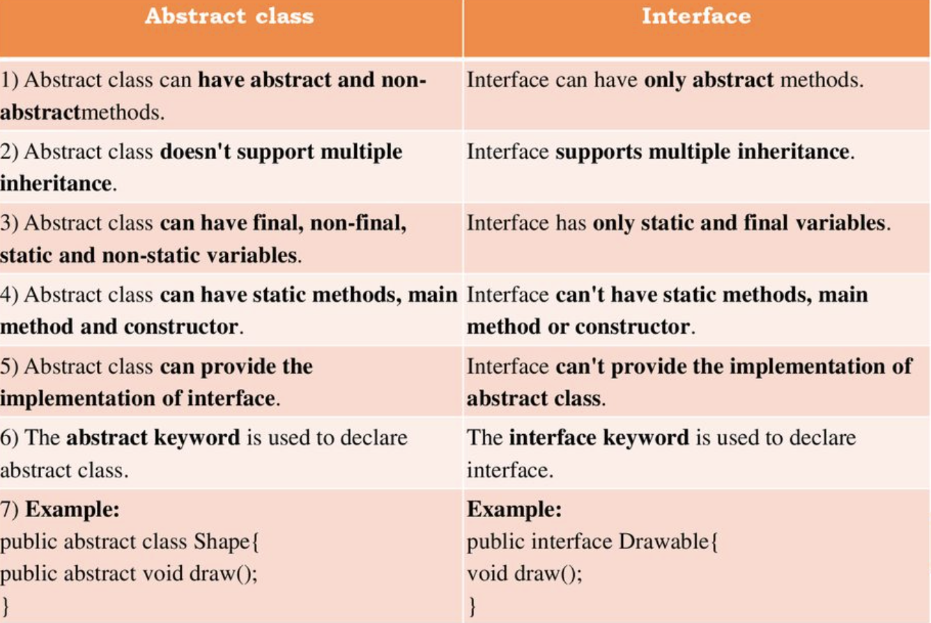
How Abstract classes differ from Interfaces

Slide 21
Thanks!

